Slide 1


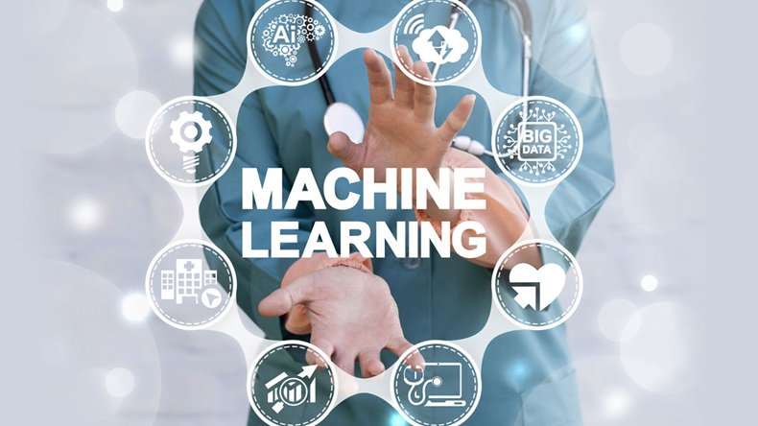
Data Science in Modern Medicine
Asst. Prof. Dr. Watshara Shoombuatong
Center of Data Mining and Biomedical Informatics
watshara.sho@mahidol.ac.th

Slide 2


Slide 3
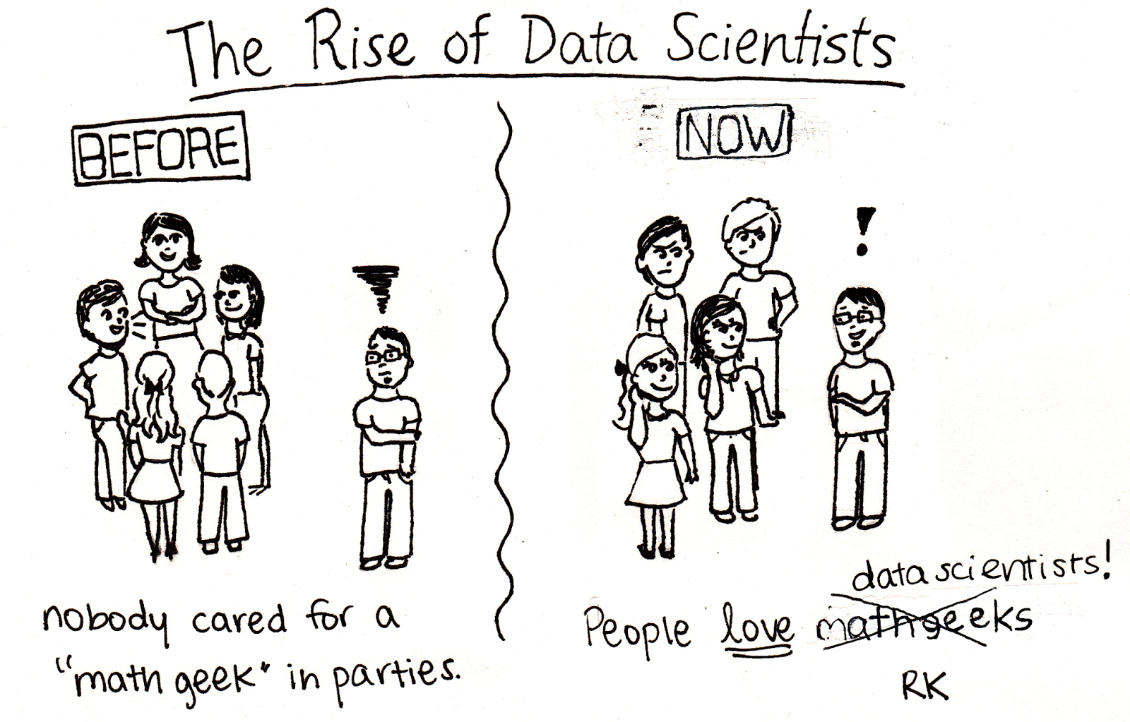

Slide 4
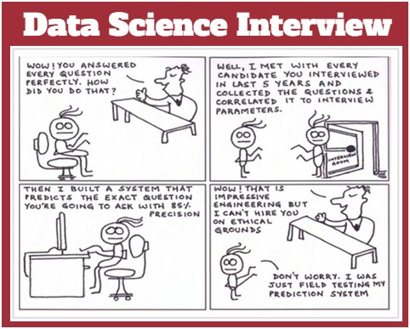

Slide 5
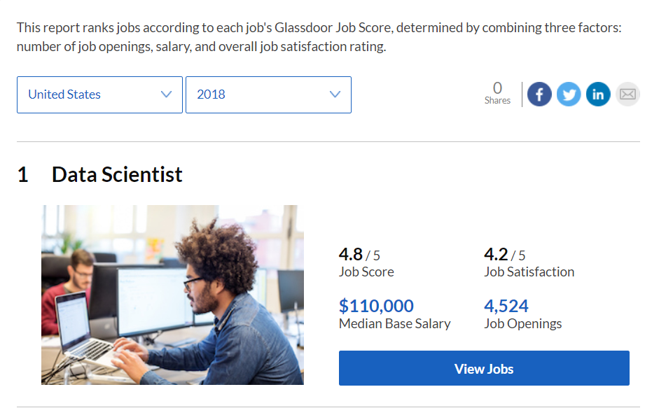
เกณฑ์การตัดสินจากจำนวนตำแหน่งงานที่เปิดรับ ข้อมูลฐานเงินเดือนเฉลี่ย และคะแนนเรตติ้งเกี่ยวกับโอกาสทางการงาน
‘Data Scientist เป็นหนึ่งในสาขาวิชาชีพที่กำลังมาแรงมากที่สุดในศตวรรษที่ 21’ จากตำแหน่งอาชีพที่แทบไม่มีใครรู้จัก
ในปี 2014 มหาวิทยาลัยนิวยอร์กได้เพิ่มหลักสูตรและปริญญาโทด้าน Data Science โดยเฉพาะ
Photo: glassdoor.com

Slide 6
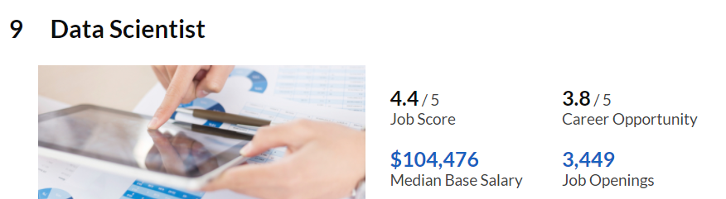
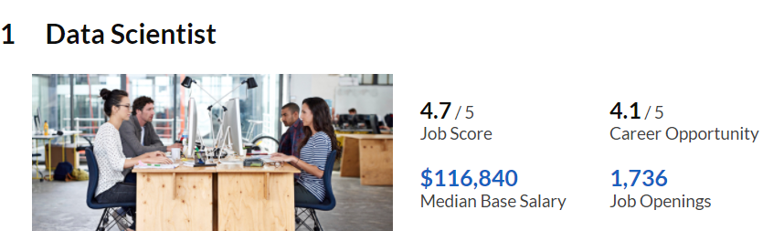
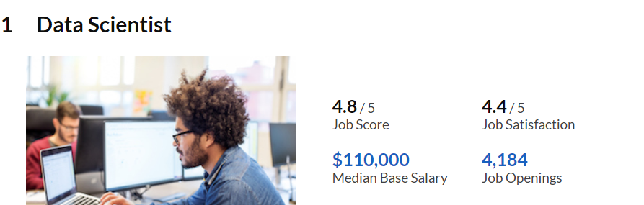
(2015)
ในปี 2014 มหาวิทยาลัยนิวยอร์กได้เพิ่มหลักสูตรและปริญญาโทด้าน Data Science โดยเฉพาะ
(2016)
(2017)
Photo: glassdoor.com

Slide 7
Demand For Data Scientists
Advertised machine learning skills are paying an average of $114,000.
Advertised data scientist jobs pay an average of $105,000.
Advertised data engineering jobs pay an average of $117,000.
https://www.forbes.com/sites/louiscolumbus/2017/05/13/ibm-predicts-demand-for-data-scientists-will-soar-28-by-2020/#3588cff27e3b

Slide 8

สำหรับประเทศไทย “EIC” เผยว่าอุปทานของ Data Scientist ในไทยยังมีอยู่ค่อนข้างน้อยเมื่อเทียบกับสหรัฐฯ จากการสืบค้นข้อมูลจาก LinkedIn พบว่าผู้ที่ระบุว่าตนเองทำงานเป็น Data Scientist ในไทยมีเพียง 200 บัญชี เทียบกับสหรัฐฯ ที่มี 44,000 บัญชี
แม้ว่าตอนนี้มหาวิทยาลัยในไทยจะเริ่มเปิดหลักสูตรเฉพาะทางด้าน Data Science แต่ก็มีอยู่เพียงไม่กี่แห่งเท่านั้น และจำนวนนักศึกษาที่ผลิตได้ก็ยังมีอยู่น้อย

Slide 9
แต่คาดว่าความต้องการ Data Scientist ในตลาดแรงงานจะมีมากถึง 2,000 คน
มีอัตราเติบโตเฉลี่ยอยู่ที่ประมาณ 15% ในช่วง 2 – 3 ปีข้างหน้า
ในอนาคตอันใกล้จึงมีความเป็นไปได้สูงที่บริษัทต่างๆ ทั้งธุรกิจขนาดใหญ่ในหลายอุตสาหกรรม ตลอดจนธุรกิจ start-up และ SMEs ด้านเทคโนโลยี จะต้องการ Data Scientist มากขึ้นเพื่อสร้างองค์ความรู้จากข้อมูลขนาดใหญ่ที่มีอยู่

Slide 10


Slide 11
ส่องปัญหาวิกฤติ Data Scientist ไทยกัน
บริษัทต้องการคนมีประสบการณ์
บริษัทหลายๆ ที่เองก็กำลังตื่นตัวจะสร้างทีม data scientist ขึ้นมาภายในองค์กร ทำให้อยากได้คนที่มีประสบการณ์แล้ว
บางบริษัทก็ใช้วิธีรับเด็กจบใหม่ที่เก่งๆ เข้ามา เพื่อที่จะเอามาฝึกมาปั้นเองในองค์กร แต่ก็ต้องอาศัยคนที่มีประสบการณ์ด้าน data scientist จนก็ต้องกลับไปที่ปัญหาเดิม คือ บริษัทอยากได้คนมีประสบการณ์เข้ามาทำงานตำแหน่งนี้
https://medium.com/@sinart.t/%E0%B8%AA%E0%B9%88%E0%B8%AD%E0%B8%87%E0%B8%9B%E0%B8%B1%E0%B8%8D%E0%B8%AB%E0%B8%B2%E0%B8%A7%E0%B8%B4%E0%B8%81%E0%B8%A4%E0%B8%95%E0%B8%B4-data-scientist-%E0%B9%84%E0%B8%97%E0%B8%A2%E0%B8%81%E0%B8%B1%E0%B8%99-e66722763322

Slide 12
ส่องปัญหาวิกฤติ Data Scientist ไทยกัน
บริษัทใหญ่ๆ ใช้เงินซื้อตัว บริษัทเล็กเลยลำบาก
เนื่องจากว่า data scientist นั้นยังมี demand ที่สูงมากในตลาดแรงงานตอนนี้ ยิ่งถ้ามีประสบการณ์หรือมีโปรไฟล์ดีๆ ก็จะยิ่งเป็นที่ต้องการมาก
ทำให้เกิดการงัดกลยุทธ์ต่างๆ มาใช้ในการดึงตัวคนเข้าไป รวมไปถึงการให้อัตราเงินเดือนที่สูงมากเป็นสิ่งล่อใจให้คนเก่งๆ
ทำให้การหา data scientist ที่ว่ายากอยู่แล้ว กลับเป็นยากหนักหนาเข้าไปอีกสำหรับบริษัทเล็ก
https://medium.com/@sinart.t/%E0%B8%AA%E0%B9%88%E0%B8%AD%E0%B8%87%E0%B8%9B%E0%B8%B1%E0%B8%8D%E0%B8%AB%E0%B8%B2%E0%B8%A7%E0%B8%B4%E0%B8%81%E0%B8%A4%E0%B8%95%E0%B8%B4-data-scientist-%E0%B9%84%E0%B8%97%E0%B8%A2%E0%B8%81%E0%B8%B1%E0%B8%99-e66722763322

Slide 13
ส่องปัญหาวิกฤติ Data Scientist ไทยกัน
หลายๆ คนยังขาดประสบการณ์ทางด้าน data science
ถ้าย้อนกลับไปเมื่อ 3–4 ปีที่แล้ว คำว่า data scientist แทบจะไม่ปรากฎอยู่ในตำแหน่งพนักงานบริษัทในไทย ซึ่งก็เพราะความที่มันเป็นงานที่เพิ่งจะมีมาใหม่ มันก็เลยยากที่จะหาคนที่จะมีประสบการณ์ด้านนี้
หลายคนที่อยากจะฝึกทักษะด้าน data science ก็เลยใช้วิธีศึกษาคอร์สออนไลน์ หรือคอร์สเรียนในสถานศึกษาต่างๆ และทำตาม tutorial การบ้าน หรือโปรเจคต่างๆ ที่คอร์สเรียนนั้นได้กำหนดไว้ให้เป็นการฝึกฝีมือ
แต่ … ข้อมูล หรือปัญหาต่างๆ ที่อยู่ตามคอร์สเรียนส่วนใหญ่ก็จะมีวัตถุประสงค์หลักๆ คือ เพื่อให้เห็นภาพและเข้าใจการทำงานของโมเดล ดังนั้นข้อมูลหรือปัญหาที่เค้าเตรียมให้ ก็มักจะไม่ได้มีความซับซ้อนเหมือนกับปัญหาหรือข้อมูลจริงในชีวิตการทำงาน

Slide 14

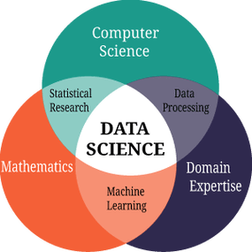
ส่องปัญหาวิกฤติ Data Scientist ไทยกัน
ยังมีคนที่เน้นทักษะด้านเดียวอยู่เป็นจำนวนมาก

Slide 16
Photo: glassdoor.com

Slide 17
(2015)
(2016)
(2017)
Photo: glassdoor.com

Slide 19
Why to learn Data Science?
The Internet has an Incredible easy way to gather any kind of information.
Even you can get an idea about how to design your own flight :) Yes, we can get whatever we want.
But the subject is how we are going to use these data efficiently?

Slide 20
Why to learn Data Science?
If we want to succeed, we must be adopted and updated to the latest trends and technologies.
In Today’s world, everything depends on the data, from Tea shop to Multi-National companies relying upon their data.
Now we understand that Data is very essential, so we have to start analyzing.
The major role of Data Scientist is to analyze their company’s data and determines good tactics for their company future according to the current situation of the market. Sounds good?

Slide 21
Why to learn Data Science?
Data analytics is the heartbeat of all top organizations
Data Science is everywhere
You become Decision-Making person
Data Science is rapidly increasing than expected
Offering new revenue strategies

Slide 22
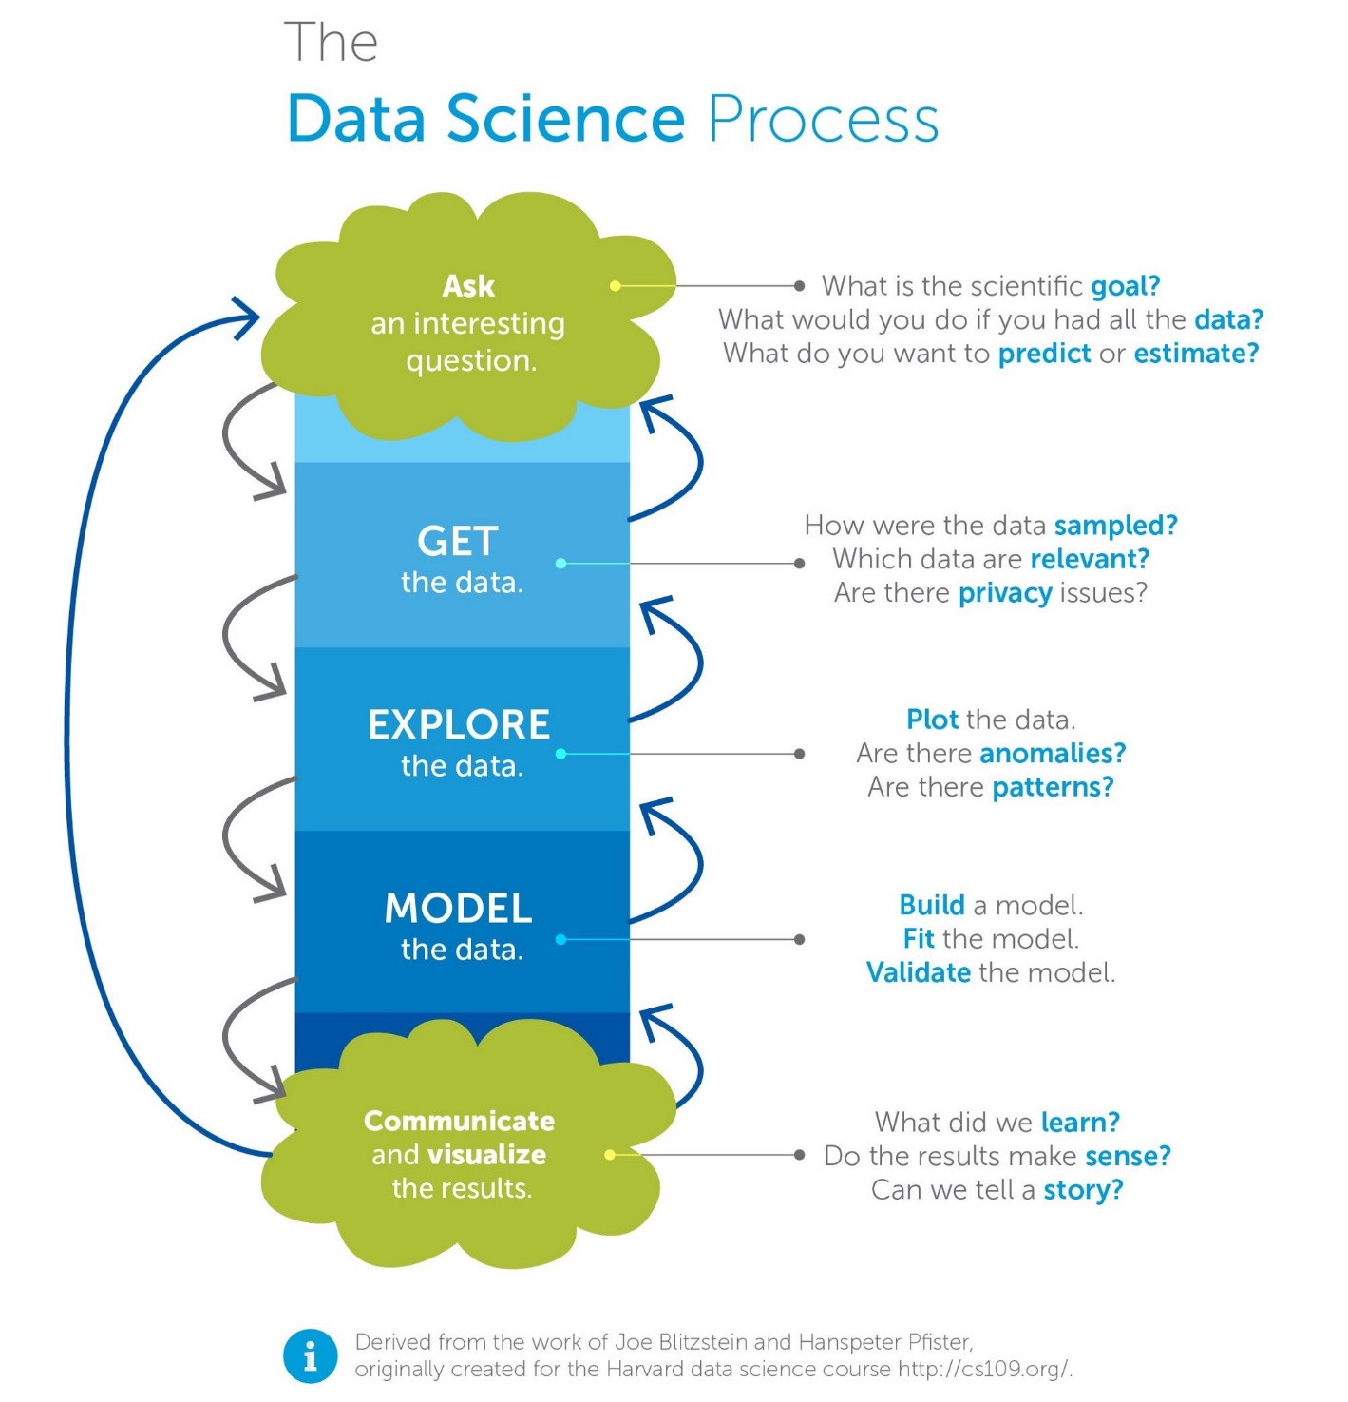

Slide 23
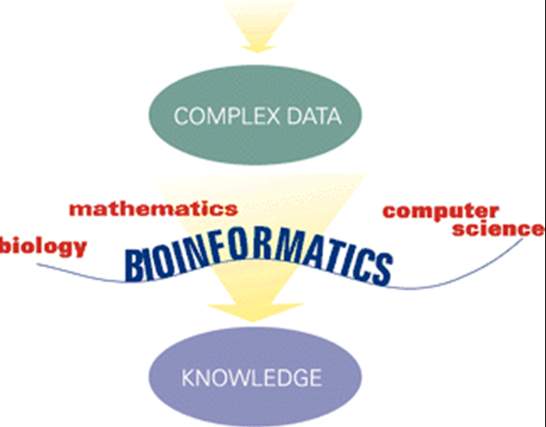
What is Bioinformatics?

Slide 24
What is Bioinformatics?
Conceptualizing biology in terms of molecules and then applying “informatics” techniques from math, computer science, and statistics to understand and organize the information associated with these molecules on a large scale

Slide 25
What are bioinformaticians up to, actually?
Manage molecular biological data
Store in databases, organise, formalise, describe...
Compare molecular biological data
Find patterns in molecular biological data
phylogenies
correlations (sequence / structure / expression / function / disease)‏

Slide 26
What are bioinformaticians up to, actually?
Goals:
characterise biological patterns & processes
predict biological properties
low level data ⇒ high level properties
(eg., sequence ⇒ function)‏

Slide 27
Bioinformatics: neighbour disciplines
Computational biology
Broader concept: includes computational ecology, physiology, neurology etc...
-omics:
Genomics
Transcriptomics
Proteomics
Systems biology
Putting it all together...
Building models, identify control & regulation

Slide 28
Bioinformatics: prerequisites
Bio- side:
Molecular biology
Cell biology
Genetics
Evolutionary theory
-informatics side:
Computer science
Statistics
Theoretical physics

Slide 29
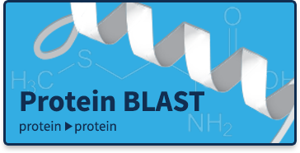

Slide 30
>gb|BE588357.1|BE588357 194087 BARC 5BOV Bos taurus cDNA 5'.
Length = 369
Score = 272 bits (137), Expect = 4e-71
Identities = 258/297 (86%), Gaps = 1/297 (0%)
Strand = Plus / Plus
Query: 17 aggatccaacgtcgctccagctgctcttgacgactccacagataccccgaagccatggca 76
|||||||||||||||| | ||| | ||| || ||| | |||| ||||| |||||||||
Sbjct: 1 aggatccaacgtcgctgcggctacccttaaccact-cgcagaccccccgcagccatggcc 59
Query: 77 agcaagggcttgcaggacctgaagcaacaggtggaggggaccgcccaggaagccgtgtca 136
|||||||||||||||||||||||| | || ||||||||| | ||||||||||| ||| ||
Sbjct: 60 agcaagggcttgcaggacctgaagaagcaagtggagggggcggcccaggaagcggtgaca 119
Query: 137 gcggccggagcggcagctcagcaagtggtggaccaggccacagaggcggggcagaaagcc 196
|||||||| | || | ||||||||||||||| ||||||||||| || ||||||||||||
Sbjct: 120 tcggccggaacagcggttcagcaagtggtggatcaggccacagaagcagggcagaaagcc 179
Query: 197 atggaccagctggccaagaccacccaggaaaccatcgacaagactgctaaccaggcctct 256
||||||||| | |||||||| |||||||||||||||||| ||||||||||||||||||||
Sbjct: 180 atggaccaggttgccaagactacccaggaaaccatcgaccagactgctaaccaggcctct 239
Query: 257 gacaccttctctgggattgggaaaaaattcggcctcctgaaatgacagcagggagac 313
|| || ||||| || ||||||||||| | |||||||||||||||||| ||||||||
Sbjct: 240 gagactttctcgggttttgggaaaaaacttggcctcctgaaatgacagaagggagac 296
Notes:
29

Slide 31
Understand the Statistics!
BLAST produces an E-value for every match
This is the same as the P value in a statistical test
A match is generally considered significant if the E-value < 0.05 (smaller numbers are more significant)
Very low E-values (e⁻¹⁰⁰) are homologs or identical genes
Moderate E-values are related genes
Long regions of moderate similarity are more important than short regions of high identity.

Slide 32
BLAST is Approximate
BLAST makes similarity searches very quickly because it takes shortcuts.
looks for short, nearly identical “words” (11 bases)
It also makes errors
misses some important similarities
makes many incorrect matches
easily fooled by repeats or skewed composition
Notes:
30

Slide 33

Machine learning

Slide 34
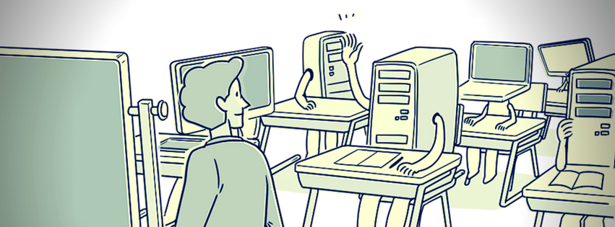
Machine learning
Machine Learning is the science of getting computers to learn and act like humans do, and improve their learning over time in autonomous fashion, by feeding them data and information in the form of observations and real-world interactions.”

Slide 35
Why “Learn”?
Machine learning is programming computers to optimize a performance criterion using example data or past experience.
Learning is used when:
Human expertise does not exist (navigating on Mars),
Humans are unable to explain their expertise (speech recognition)
Solution changes in time (routing on a computer network)
Solution needs to be adapted to particular cases (user biometrics)

Slide 36
Growth of Machine Learning
Machine learning is preferred approach to
Speech recognition, Natural language processing
Computer vision
Medical outcomes analysis
Robot control
Computational biology

Slide 37








Face Recognition
Training examples of a person
Test images
AT&T Laboratories, Cambridge UK
http://www.uk.research.att.com/facedatabase.html

Slide 38
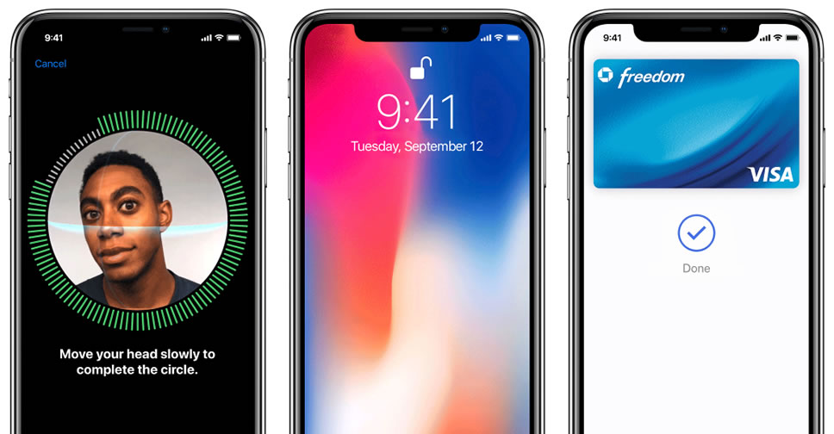

Slide 39
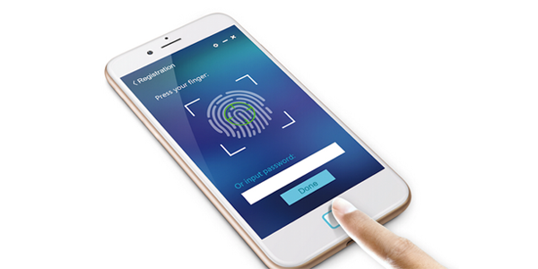

Slide 40
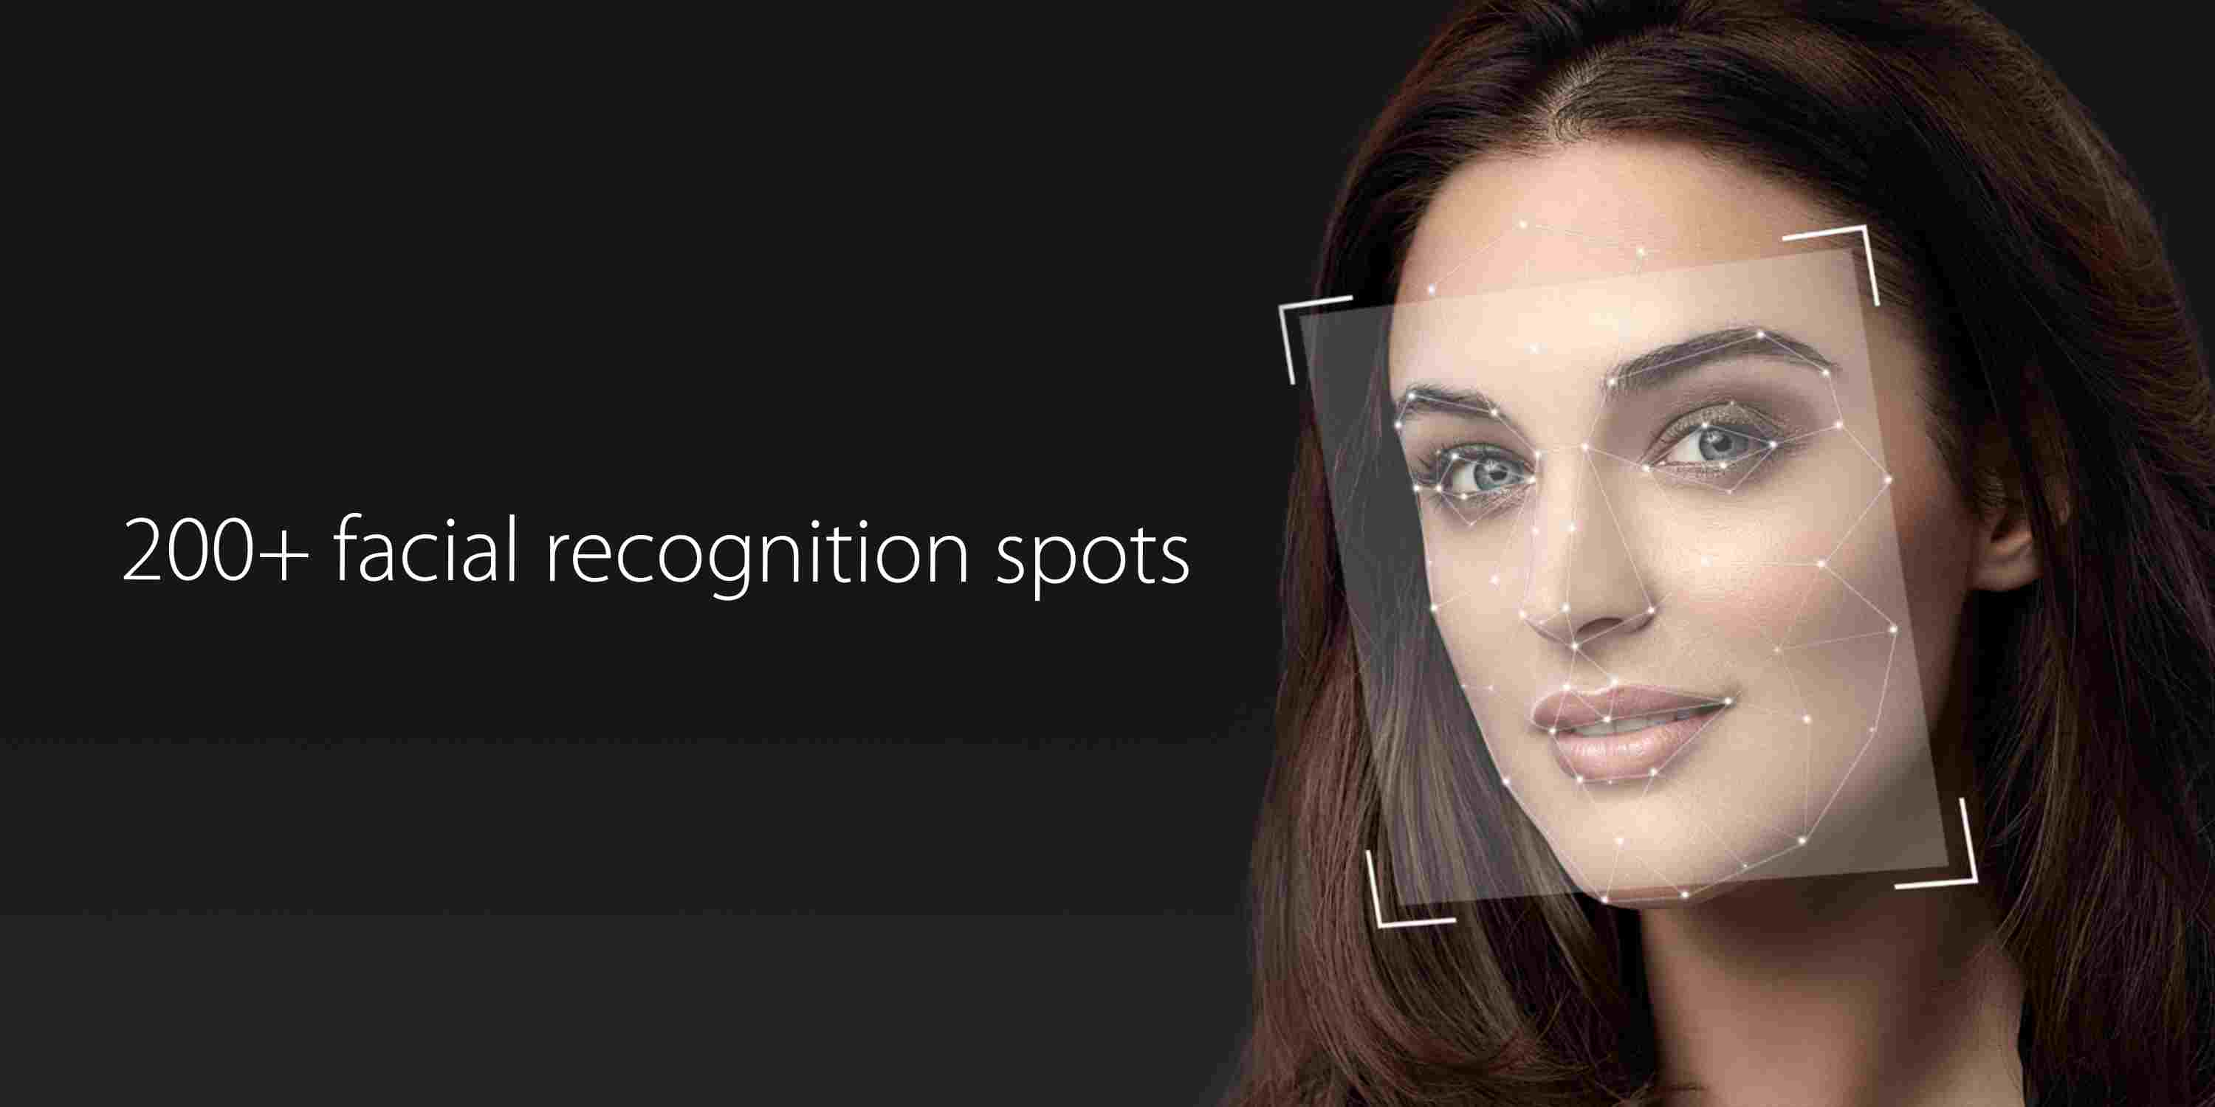

Slide 41
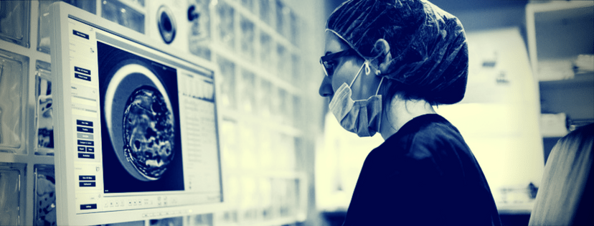
Applications of Machine Learning in Pharma and Medicine

Slide 42
Disease Identification/Diagnosis

Slide 43
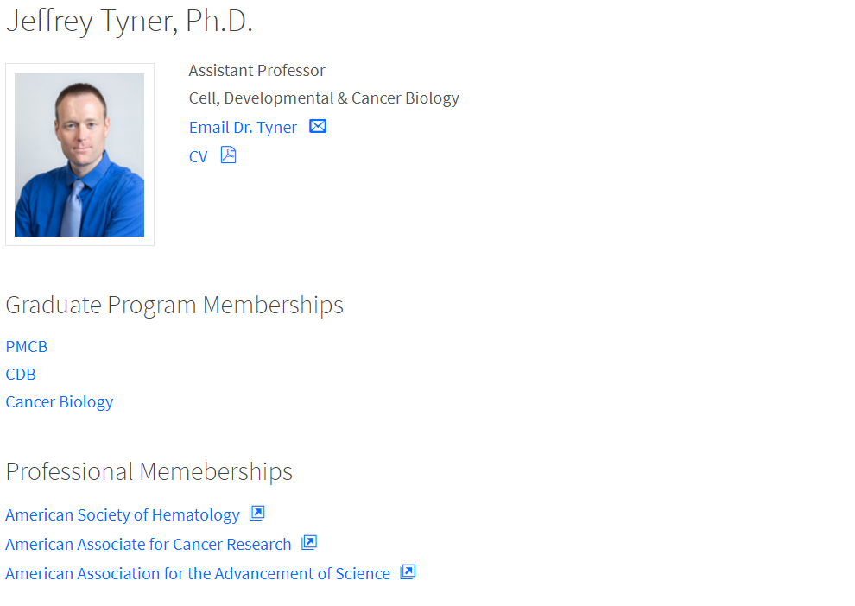
In an interview with Bloomberg Technology, Knight Institute Researcher Jeff Tyner stated that while this is exciting, it also presents the challenge of finding ways to work with all the resulting data.
“That is where the idea of a biologist working with information scientists and computationalists is so important,” said Tyner.
https://www.techemergence.com/machine-learning-in-pharma-medicine/

Slide 44
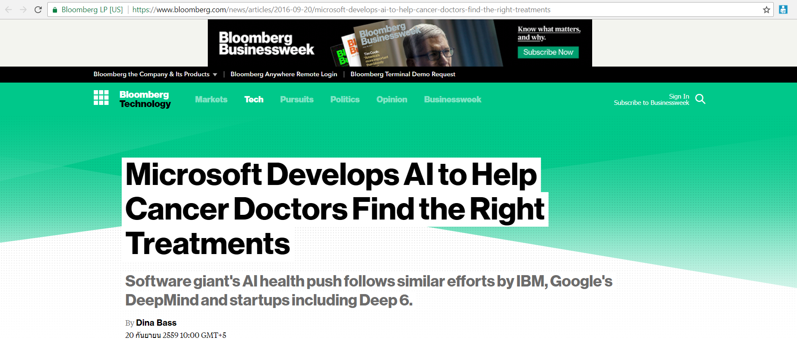
https://www.techemergence.com/machine-learning-in-pharma-medicine/

Slide 45
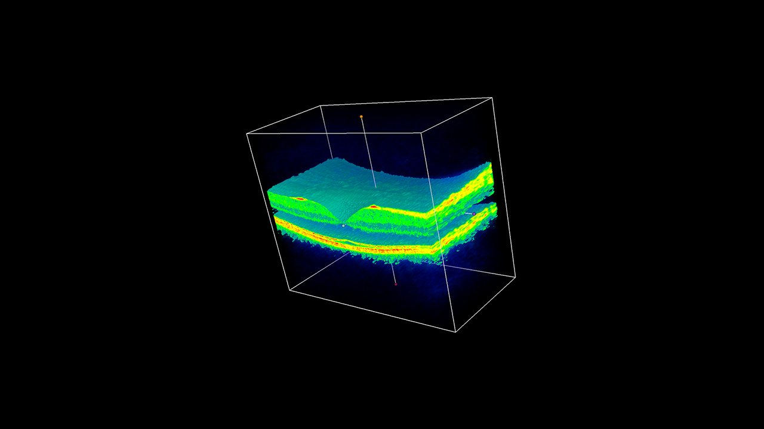
Other major examples include Google’s DeepMind Health, which last year announced multiple UK-based partnerships, including with Moorfields Eye Hospital in London, in which they’re developing technology to address macular degeneration in aging eyes.
https://www.techemergence.com/machine-learning-in-pharma-medicine/

Slide 46
Personalized Treatment/Behavioral Modification

Slide 47
Personalized medicine, or more effective treatment based on individual health data paired with predictive analytics, is also a hot research area and closely related to better disease assessment.
The domain is presently ruled by supervised learning, which allows physicians to select from more limited sets of diagnoses, for example, or estimate patient risk based on symptoms and genetic information.
https://www.techemergence.com/machine-learning-in-pharma-medicine/

Slide 48
Somatix – a data-analytics B2B2C software platform company whose ML-based app uses “recognition of hand-to-mouth gestures in order to help people better understand their behavior and make life-affirming changes”, specifically in smoking cessation.
https://www.techemergence.com/machine-learning-in-pharma-medicine/

Slide 49

https://www.techemergence.com/machine-learning-in-pharma-medicine/

Slide 50
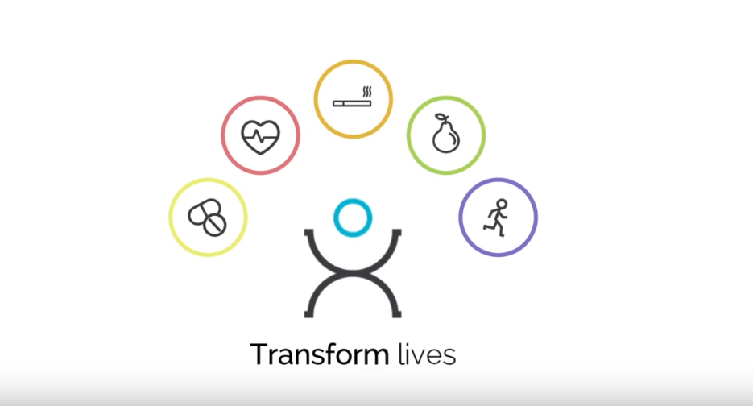
https://www.techemergence.com/machine-learning-in-pharma-medicine/

Slide 51
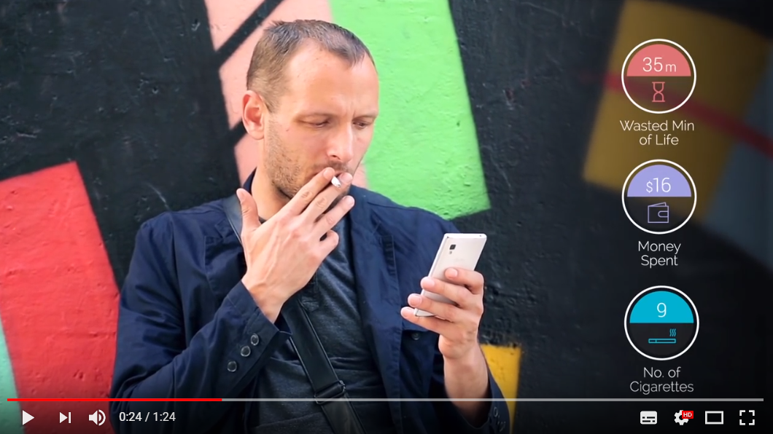
https://www.techemergence.com/machine-learning-in-pharma-medicine/

Slide 52
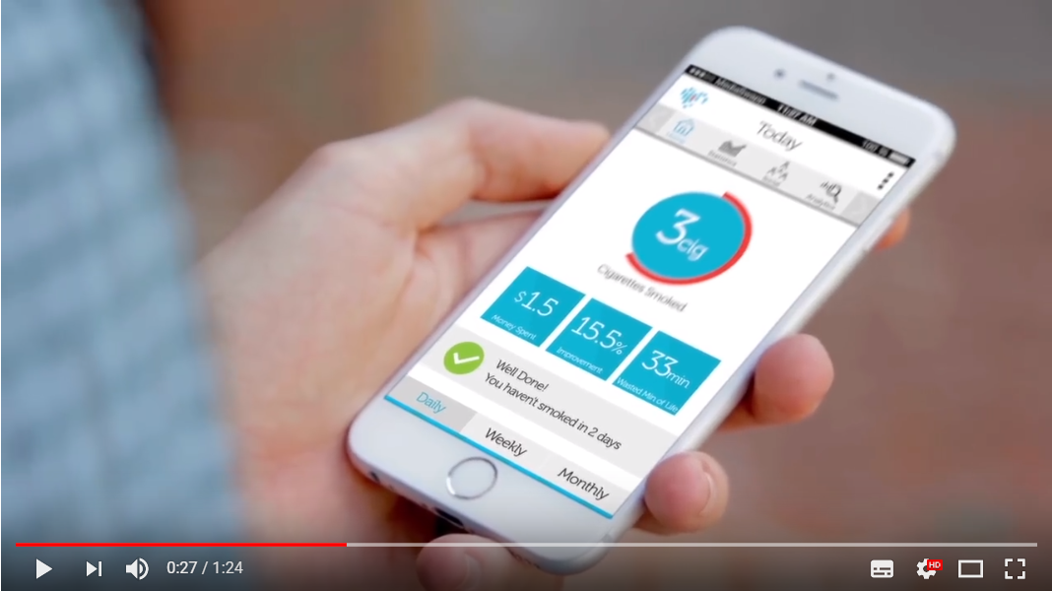

Slide 53
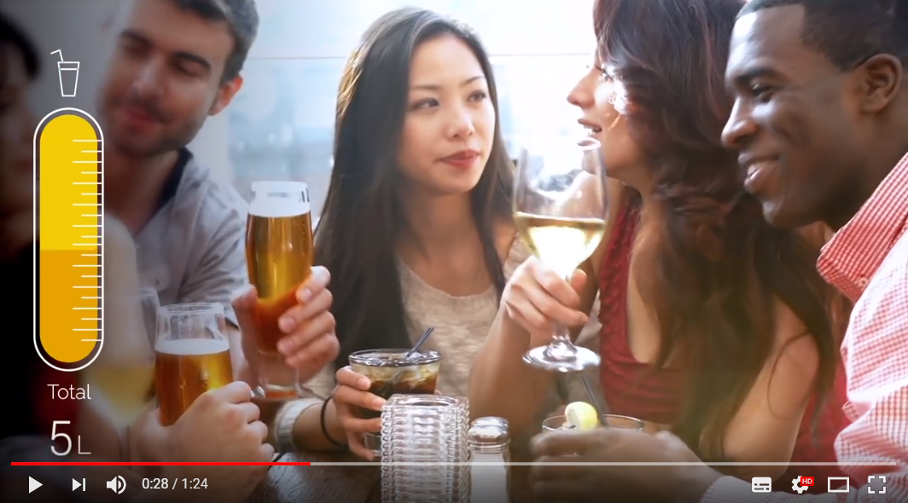

Slide 54
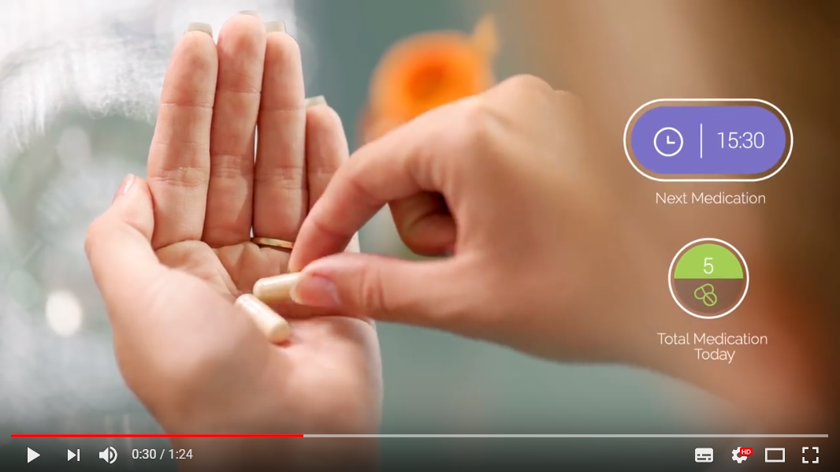

Slide 55
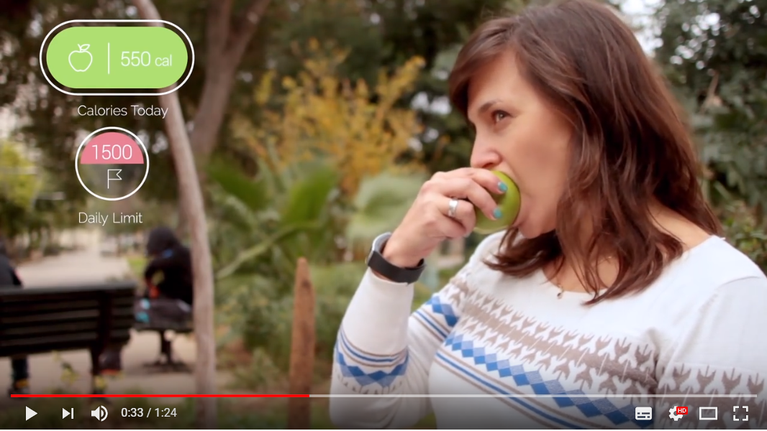

Slide 56
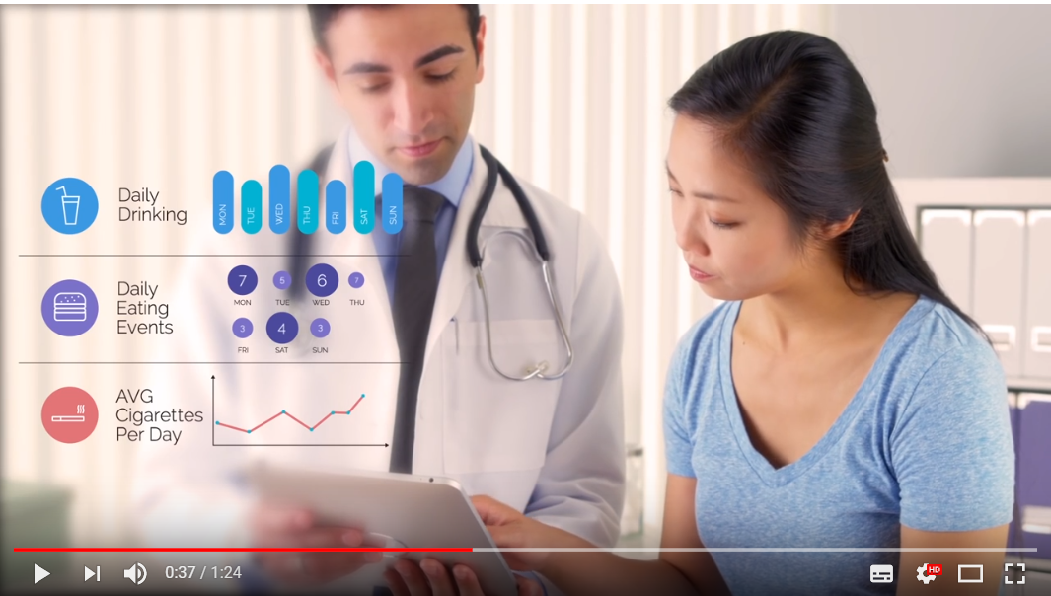

Slide 57
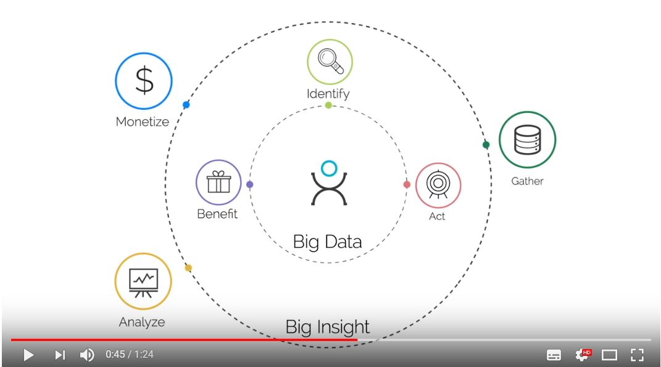

Slide 58
Drug Discovery/Manufacturing

Slide 59
The use of machine learning in preliminary (early-stage) drug discovery has the potential for various uses, from initial screening of drug compounds to predicted success rate based on biological factors.
This includes R&D discovery technologies like next-generation sequencing.
https://www.techemergence.com/machine-learning-in-pharma-medicine/

Slide 60
Epidemic Outbreak Prediction

Slide 61
Predicting outbreak severity is particularly pressing in third-world countries, which often lack medical infrastructure, educational avenues, and access to treatments.
ProMED-mail is an internet-based reporting program for monitoring emerging diseases and providing outbreak reports in real-time:
https://www.techemergence.com/machine-learning-in-pharma-medicine/

Slide 62
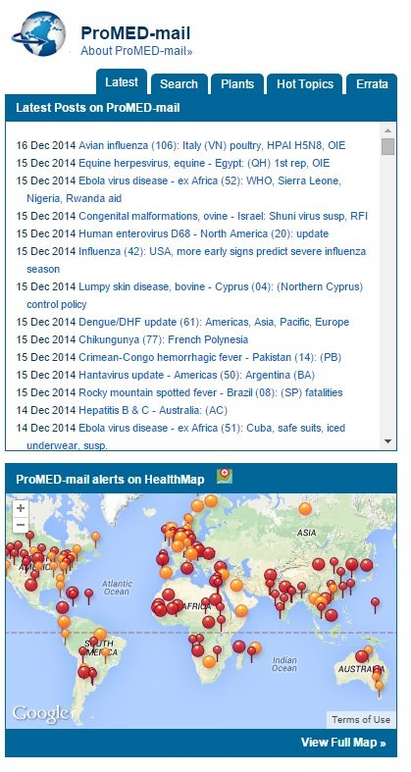
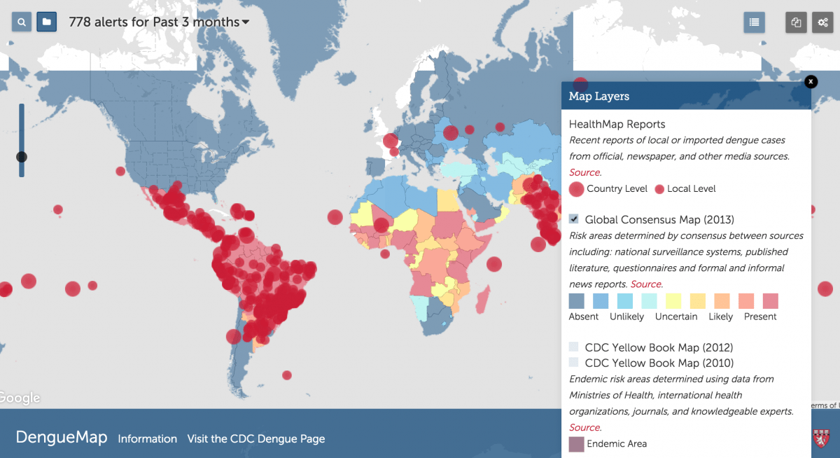

Slide 63
Radiology and Radiotherapy

Slide 64
In an October 2016 interview with Stat News, Dr. Ziad Obermeyer, an assistant professor at Harvard Medical School, stated:
“In 20 years, radiologists won’t exist in anywhere near their current form.
They might look more like cyborgs: supervising algorithms reading thousands of studies per minute.”
https://www.techemergence.com/machine-learning-in-pharma-medicine/

Slide 65
Until that day comes, Google’s DeepMind Health is working with University College London Hospital (UCLH) to develop machine learning algorithms capable of detecting differences in healthy and cancerous tissues to help improve radiation treatments.
DeepMind and UCLH are working on applying ML to help speed up the segmentation process (ensuring that no healthy structures are damaged) and increase accuracy in radiotherapy planning.
https://www.techemergence.com/machine-learning-in-pharma-medicine/

Slide 67
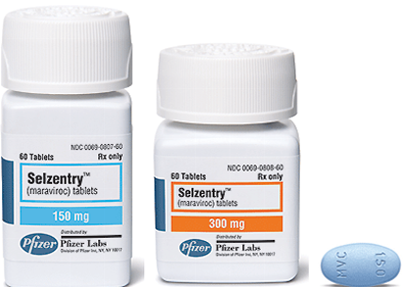
Determination of HIV-1 coreceptor usage
HIV-1 variants can be classiﬁed as R5 virus, X4 virus, and R5X4 virus .
R5 variants are generally established in an early stage infections, while X4 variants generally emerge in later stages.
M. Koot, I. Keet, A. Vos, R. de Goede, M. Roos, R. Coutinho, F. Miedema, P. Schellekens, M. Tersmette, Progmosis value of HIV-1 syncytium-inducing phenotype for rate of CD4þ cell depletion and progression to AIDs, Ann. Intern. Med. 118 (1993) 681–688.
D. Richman, S. Bozzette, The impact of the syncytium-inducing phenotype of HIV on disease progression, J. Infect. Dis. 169 (1994) 968–974.

Slide 68
Determination of HIV-1 coreceptor usage (cont.)
Maraviroc (Pﬁzer, USA) (brand-named Selzentry or Celsentri) shows activity in patients exclusively harboring R5 virus.
The efficient performance of classifying HIV-1 coreceptor usage can help to choose the most advantaged HIV treatment.
M. Koot, I. Keet, A. Vos, R. de Goede, M. Roos, R. Coutinho, F. Miedema, P. Schellekens, M. Tersmette, Progmosis value of HIV-1 syncytium-inducing phenotype for rate of CD4þ cell depletion and progression to AIDs, Ann. Intern. Med. 118 (1993) 681–688.
D. Richman, S. Bozzette, The impact of the syncytium-inducing phenotype of HIV on disease progression, J. Infect. Dis. 169 (1994) 968–974.

Slide 69
Related works
Almost genotypic predictors have been designed based on the genetic characterization of HIV-1 subtype B and C.
Therefore, using such genotypic predictors is mainly reliable for B and C viruses, and these predictors might fail to detect X4 variants.

Slide 70
Related works
Table 2.1 Comparison of our approach with existing methods
Reference | Classifier | Dataset |  | features | #feature | feature selection
 |  | training | testing
Fouchier et al, 1992 | Rule based | 271 | - | V3 amino acid sequence | 35 | No
Resch et al, 2001 | NN | 181 | - | V3 amino acid sequence | 35 | No
Pillai et al, 2003 | SVM | 271 | - | V3 amino acid sequence | 35 | No
Jensen et al, 2003 | Threshold | 213 | 175 | PSSM | 400 | No
Jensen et al, 2006 | Threshold | 279 | - | PSSM | 400 | No
Sing et al, 2007 | SVM(Geno2pheno) | 1,100 | - | V3 amino acid sequence | 35 | No
Shoombuatong et al, 2012 | SVM | 273 | - | V3 amino acid sequence | 9 | LMT
NN = Neural network, PSSM = Position specific scoring, SVM = Support vector machines
LMT = Logistic model trees

Slide 71
In this study
Our hypothesis:
Most genotypic tools have been designed based on a data set of the HIV-1 subtype B or C that seemed to be reliable only for these subtypes.
Since the CRF01_AE of HIV-1 is the predominant circulating subtype found in Thailand and Southeast Asia, there is an urgent need to know the genotypic predictors for this subtype.
Thus, in this work, the support vector machine (SVM) method was used to specifically classify the HIV-1 coreceptor CRF01_AE subtype. And we also applied the logistic model tree (LMT) method to select the most informative positions from the V3 amino acid sequences for CRF01_AE subtype.

Slide 72
Determination of HIV-1 coreceptor usage(cont.)
Phenotypic assay | Genotypic assay or computational approach
Based on a pseudotyped or recombinant virus | Based on amino acid sequences of V3
Very complex, time-consuming, laborious, and expensive . | Cheap and fast

Slide 73
Determination of HIV-1 coreceptor usage(cont.)
Phenotypic assay | Genotypic assay or computational-based method
Based on a pseudotyped or recombinant virus | Based on using directly amino acid sequences of V3 loop
Very complex, time-consuming, laborious, and expensive . | Cheap and fast

Slide 74
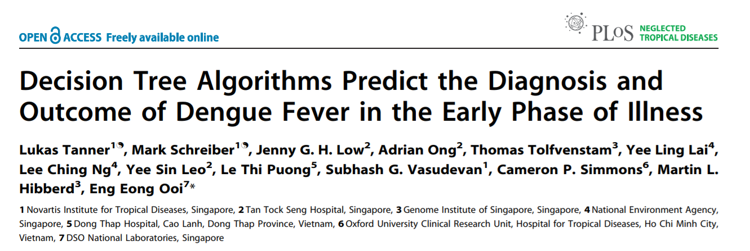

Slide 75
Applications of DT in Pharma and Medicine
A total of 1,200 patients presenting in the first 72 hours of acute febrile illness were recruited and followed up for up to a 4-week period prospectively; 1,012 of these were recruited from Singapore and 188 from Vietnam.

Slide 76
Of these, 364 were dengue RT-PCR positive; 173 had dengue fever, 171 had dengue hemorrhagic fever, and 20 had dengue shock syndrome as final diagnosis.
Using a C4.5 decision tree classifier for analysis of all clinical, haematological, and virological data, we obtained a diagnostic algorithm that differentiates dengue from non-dengue febrile illness with an accuracy of 84.7%.

Slide 77
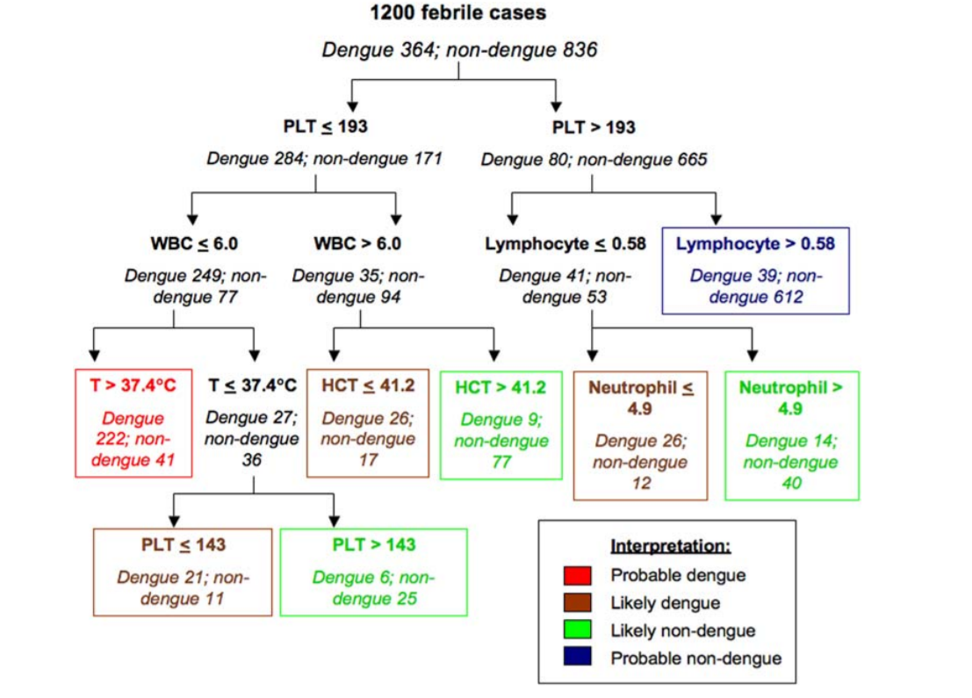

Slide 78

Chinese AI beats 15 doctors in tumor diagnosis competition

Slide 79
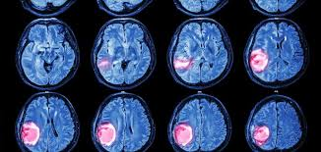
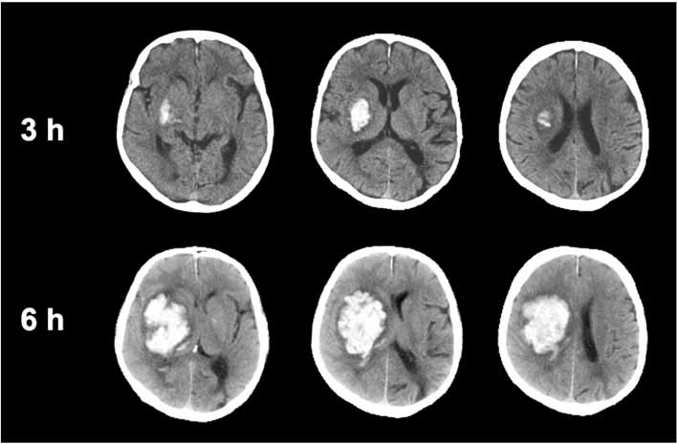
An AI system has wiped the floor with some of China’s top doctors when it comes to diagnosing brain tumors and predicting hematoma expansion.
Brain tumors
Hematoma expansion

Slide 80
Chinese AI beats 15 doctors in tumor diagnosis competition
(Round 1) When diagnosing brain tumors, BioMind was correct 87 percent of the time, compared to 66 percent by the medical professionals.
The AI also only took 15 minutes to diagnose the 225 cases, while doctors took 30 minutes.

Slide 81
Chinese AI beats 15 doctors in tumor diagnosis competition
(Round 2) In regards to predicting brain hematoma expansion, BioMind was victorious again, as it was correct in 83 percent of cases, with humans managing only 63 percent.

Slide 82
Chinese AI beats 15 doctors in tumor diagnosis competition
The executive vice-president of Beijing Tiantan Hospital, Wang Yongjun, told Xinhua that he didn’t care who won in the battle between doctors and the AI.
“I hope through this competition, doctors can experience the power of artificial intelligence,” he said. “This is especially so for some doctors who are skeptical about artificial intelligence. I hope they can further understand AI and eliminate their fears toward it.”

Slide 83


Slide 84
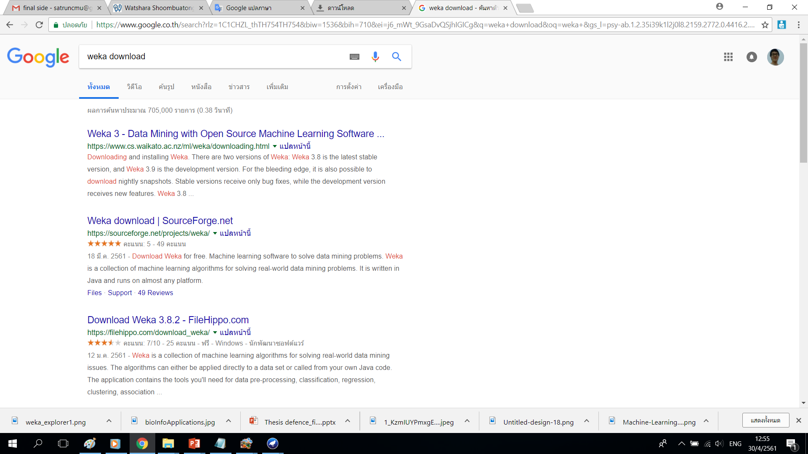

Slide 85
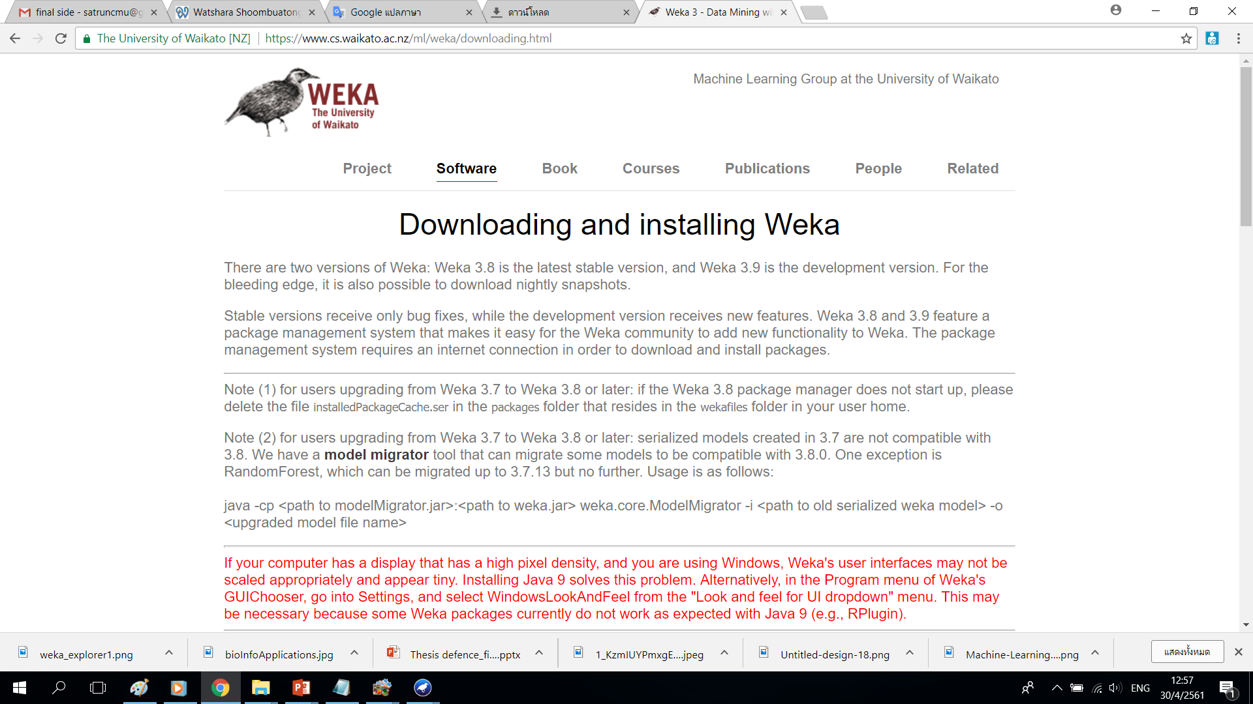

Slide 86
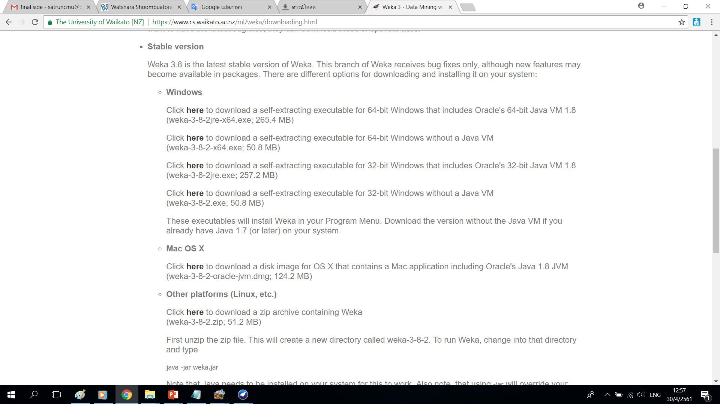

Slide 87
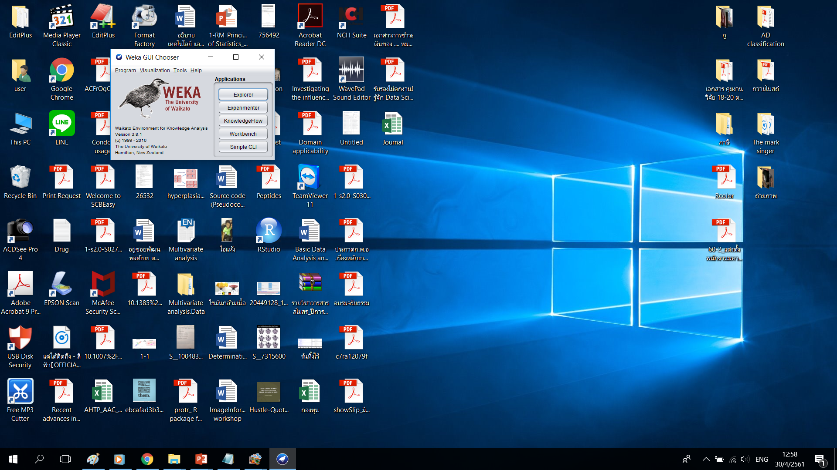

Slide 88


Slide 89


Slide 90


Slide 91


Slide 92
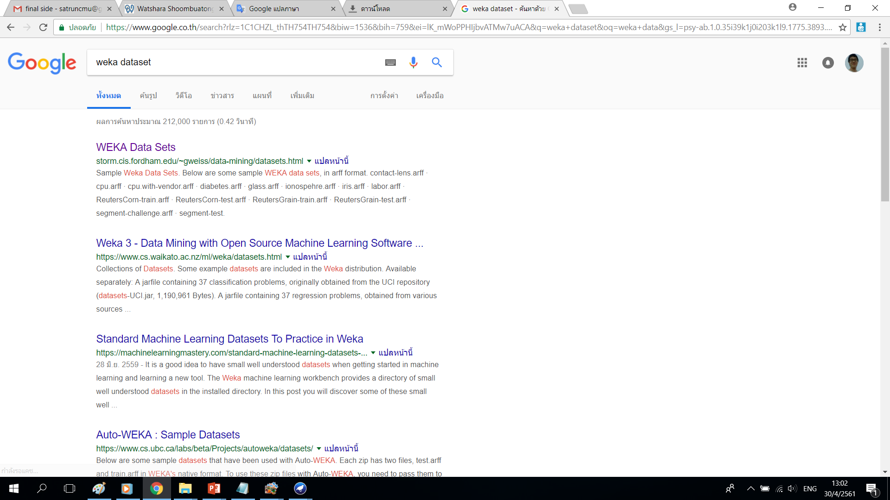

Slide 93
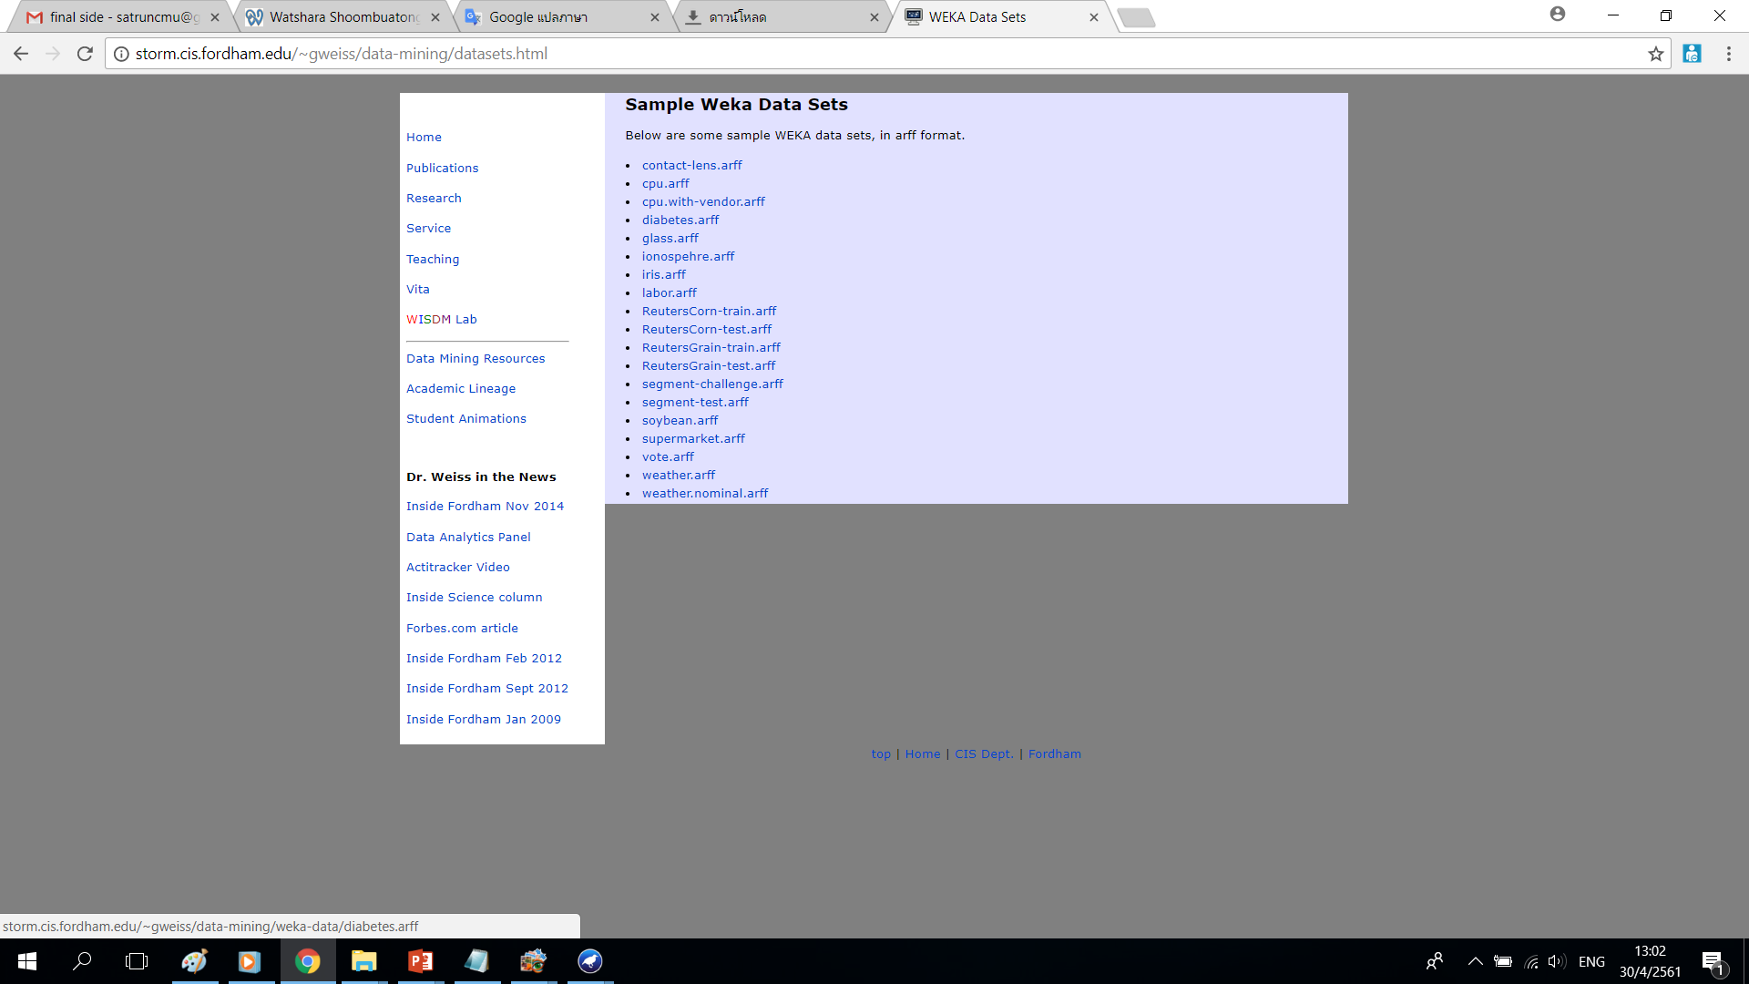

Slide 94
